Slide 1
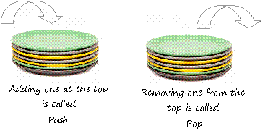
STACK
If we consider a stack of plates in a cafeteria, we can perform limited operations on the stack of plates like
adding a new plate at the top.
removing a plate from the top.
Here adding a new plate on the top of plates stack is called push operation.
Removing a plate from the top of the stack is called pop operation.
Limitation with the stack is that, it works on LIFO principle that is last added plate is first removed (Last In First Out).

Slide 2
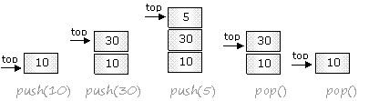
STACK
In stack new element can be added only at the top and removed only from the top that is works on LIFO (Last in first out) principle.
Adding a new element at the top of the stack is called push and removing an element from the top of the stack is called pop.
A pointer (arrow) is at the top which keeps the track of the top means it shows that the top of the stack is here.

Slide 3
X=1
Y=2
Z=3
A-4
B-5
B=5
A=4
Z=3
Y=2
X=1

Slide 4
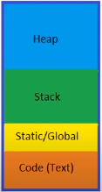
STACK

Slide 5
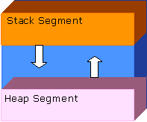
STACK
Stack segment or call stack is located in the higher part of memory and stack grows downwards as the new segments adds.
You can see a portion of memory named heap. Heap grows upwards whenever it fills in with data.
If both heap and stack meets at a point then there would be no free memory and the state is called stack overflow.
We have already seen that when main() is called, a block is assigned in memory for main as we did in class. That block of memory is basically a stack. (The memory has already fixed a big block for functions to store variables and parameters and that portion of memory is stack )

Slide 6
STACK
Every Function on stack is assigned a different block to store their local variables and parameters (if any). And that block is called Stack frame.
Local variables of functions, parameters and addresses of calling functions are pushed on the stack segment.
Stack grows as the number of functions called is increased.

Slide 7
What happens when Function is called
All the local variables and parameters are local to function.
Steps are Follows
return address is saved means address of the instruction next to the function call is pushed onto the stack e.g after function call in main which is the next statement.
All function arguments are placed on the stack.
The operations inside the function are executed.

Slide 8
What happens when a function is terminated?
Everything after the stack from stack frame is popped off. This destroys all local variables and arguments.
The return value is popped off the stack and is assigned as the value of the function.
The address of the next statement to execute is popped off the stack, and the CPU resumes execution from that statement.

Slide 9
#include <iostream>
Int square(int x)
{ return x*x; }
Int sos(int a, int b)
{ int z=square(a+b);
Return z; }
Int main()
{
Int total, x=4, y =2;
Total = sos(x,y);
Cout<< total;
}
square()
Sos()
Main()

Slide 10
#include <iostream>
Int square(int x)
{ return x*x; }
Int sos(int a, int b)
{ intz=square(a+b);
Return z; }
Int main()
{
Int total, x=4, y =2;
Total = sos(x,y);
Cout<< total;
}
Sos()
Main()

Slide 11
#include <iostream>
Int square(int x)
{ return x*x; }
Int sos(int a, int b)
{ intz=square(a+b);
Return z; }
Int main()
{
Int total, x=4, y =2;
Total = sos(x,y);
Cout<< total;
}
Main()

Slide 12
#include <iostream>
Int square(int x)
{ return x*x; }
Int sos(int a, int b)
{ intz=square(a+b);
Return z; }
Int main()
{
Int total, x=4, y =2;
Total = sos(x,y);
Cout<<total;
}

Slide 13
#include <iostream>
int sum(int,int);
int main()
{
int x,y,s;
x=30,y=67;
s=sum(x,y);
printf("Sum of two numbers %d",s);
return 0;
}
int sum(int a,int b)
{
int c;
c=a+b;
return c;
}
C=97 after sum
b=67
a=30
Return value
97
Return address to main
s
Y=67
X=30

Slide 14
#include <iostream>
int sum(int,int);
int main()
{
int x,y,s;
x=30,y=67;
s=sum(x,y);
printf("Sum of two numbers %d",s);
return 0;
}
int sum(int a,int b)
{
int c;
c=a+b;
return c;
}
C=97 after sum
b=67
a=30
Return value
97
Return address to main
s
97
Y=67
X=30

Slide 15
#include <iostream>
int sum(int,int);
int main()
{
int x,y,s;
x=30,y=67;
s=sum(x,y);
printf("Sum of two numbers %d",s);
return 0;
}
int sum(int a,int b)
{
int c;
c=a+b;
return c;
}
Return value
97
Return address to main
s
97
Y=67
X=30

Slide 16
#include <iostream>
int sum(int,int);
int main()
{
int x,y,s;
x=30,y=67;
s=sum(x,y);
printf("Sum of two numbers %d",s);
return 0;
}
int sum(int a,int b)
{
int c;
c=a+b;
return c;
}
s
97
Y=67
X=30

Slide 17
#include <iostream>
int sum(int,int);
int main()
{
int x,y,s;
x=30,y=67;
s=sum(x,y);
printf("Sum of two numbers %d",s);
return 0;
}
int sum(int a,int b)
{
int c;
c=a+b;
return c;
}

